Slide 1

Hospital Costs vs Patient Satisfaction in U.S. Healthcare
Team 2: Yangze Li, Tae Yoon Kim, Shengqi Wei, Pin-Chu Yin, Michael Allieri

Slide 2

Table of contents
01
02
03
Executive Summary
Problem Definition & Motivation
Data & Methodology
04
05
06
Key Analysis & Findings
Dashboard Showcase
Conclusion & Future Work

Slide 3

Executive Summary
01

Slide 4

Executive Summary
The Core Question: Does higher hospital spending lead to higher patient satisfaction?
Key Findings:
Cost doesn’t guarantee better experience: Higher inpatient costs do not improve satisfaction scores. In many states, hospitals with the highest severity cases show higher spending but lower satisfaction.
Strong Regional Effects: Satisfaction varies widely by state, suggesting cultural expectations and service quality shape patient experience more than cost levels.
Value Leaders Are Smaller Hospitals: Many regional hospitals achieve better “value” (higher satisfaction + lower cost) compared to large systems.
The Bottom Line: Cost is not a reliable predictor of patient experience; operational efficiency and care quality matter more.

Slide 5

Problem Definition & Motivation
02

Slide 6
Problem Definition & Motivation
Problem Definition
Hospital spending continues to rise, but patient satisfaction hasn’t improved much. We want to understand whether higher costs actually lead to better patient experience, and which hospitals deliver stronger value for the money.
Who Cares?
Hospital administrators, insurers, and policymakers need to know if their spending is truly improving outcomes. This helps them identify efficient hospitals, spot performance gaps, and make better resource decisions.
Motivation
By analyzing national hospital cost and survey data, we aim to see where spending aligns—or doesn’t—with what patients report. This gives stakeholders clearer evidence on how well healthcare dollars are being used.

Slide 7

Data & Methodology
03

Slide 8
Data Source & Preparation
Data Source
We used national hospital datasets from:
Centers for Medicare & Medicaid Services (CMS) – inpatient cost and HCAHPS patient survey data.
Open Data Marketplace – Medicare & Medicaid Hospital Quality dataset.
Data Preparation
To combine cost and satisfaction data, we completed several steps:
Standardized IDs: Unified hospital identifier formats so cost and survey data could be matched correctly.
Cleaned Records: Removed missing or inconsistent entries to keep the dataset comparable across years.
Filtered Valid Hospitals: Only kept hospitals with reliable patient survey counts.
Built a Master Dataset: Joined all cleaned CMS files into one unified table that supports all analyses in the project.
Notes:
(Hyperlink text：CMS Inpatient Hospital Data)
(Hyperlink text：Hospital Quality Data ZIP Download)

Slide 9

Key Analysis & Findings
04

Slide 10
EXPLORATORY DATA ANALYSIS
1. Costs Vary Widely Across Hospitals
Strong right-skew: most hospitals cluster in a moderate cost range.
Some hospitals spend far above the national average.
Cost variation across hospitals is much larger than satisfaction variation.
2. Spending Does Not Predict Patient Experience
Correlation between cost and satisfaction is basically zero (r ≈ 0.0004).
High-cost hospitals often still fall in the mid satisfaction band.
Several lower-cost hospitals perform just as well or even better.
3. Small Gains Over Time, Big Gaps Across States
From 2016–2020, most states only improved by about 0.1–0.3 stars.
No state gained a full +1.0 star in average rating.
Differences between states (e.g., Nevada ≈ 2 stars vs Wisconsin ≈ 4 stars) are much larger than changes within a state.

Slide 11
EXPLORATORY DATA ANALYSIS
4. Smaller / Regional Hospitals Improve Faster
Top improvers in satisfaction (Q1) are mostly small or regional hospitals.
Big hospitals in large cities showed little or no change over time.
Smaller hospitals may adapt operations and patient experience more quickly.
5. High-Value Hospitals: High Satisfaction at Lower Cost
Value Index (z-score) highlights hospitals that deliver high satisfaction with below-average cost.
Examples like Oklahoma Heart Hospital, Caldwell Memorial Hospital, and Citizens Medical Center appear repeatedly in the top 10%.
Outlier analysis finds two extremes:
High-Cost / Low-Satisfaction → inefficient
Low-Cost / High-Satisfaction → “doing more with less”

Slide 12
EXPLORATORY DATA ANALYSIS
6. What Actually Relates to Satisfaction
Cost and answer percent have very weak links with satisfaction.
HCAHPS Linear Mean Value is strongly aligned with higher star ratings.
When we control for case complexity , high-severity hospitals pay much more but do not get higher satisfaction.
Hospitals treating high-severity cases spend much more, but they do not generate higher satisfaction. As a result, the satisfaction gained per $1,000 spent is significantly lower compared to low-severity hospitals.

Slide 13

Dashboard Showcase
05

Slide 14
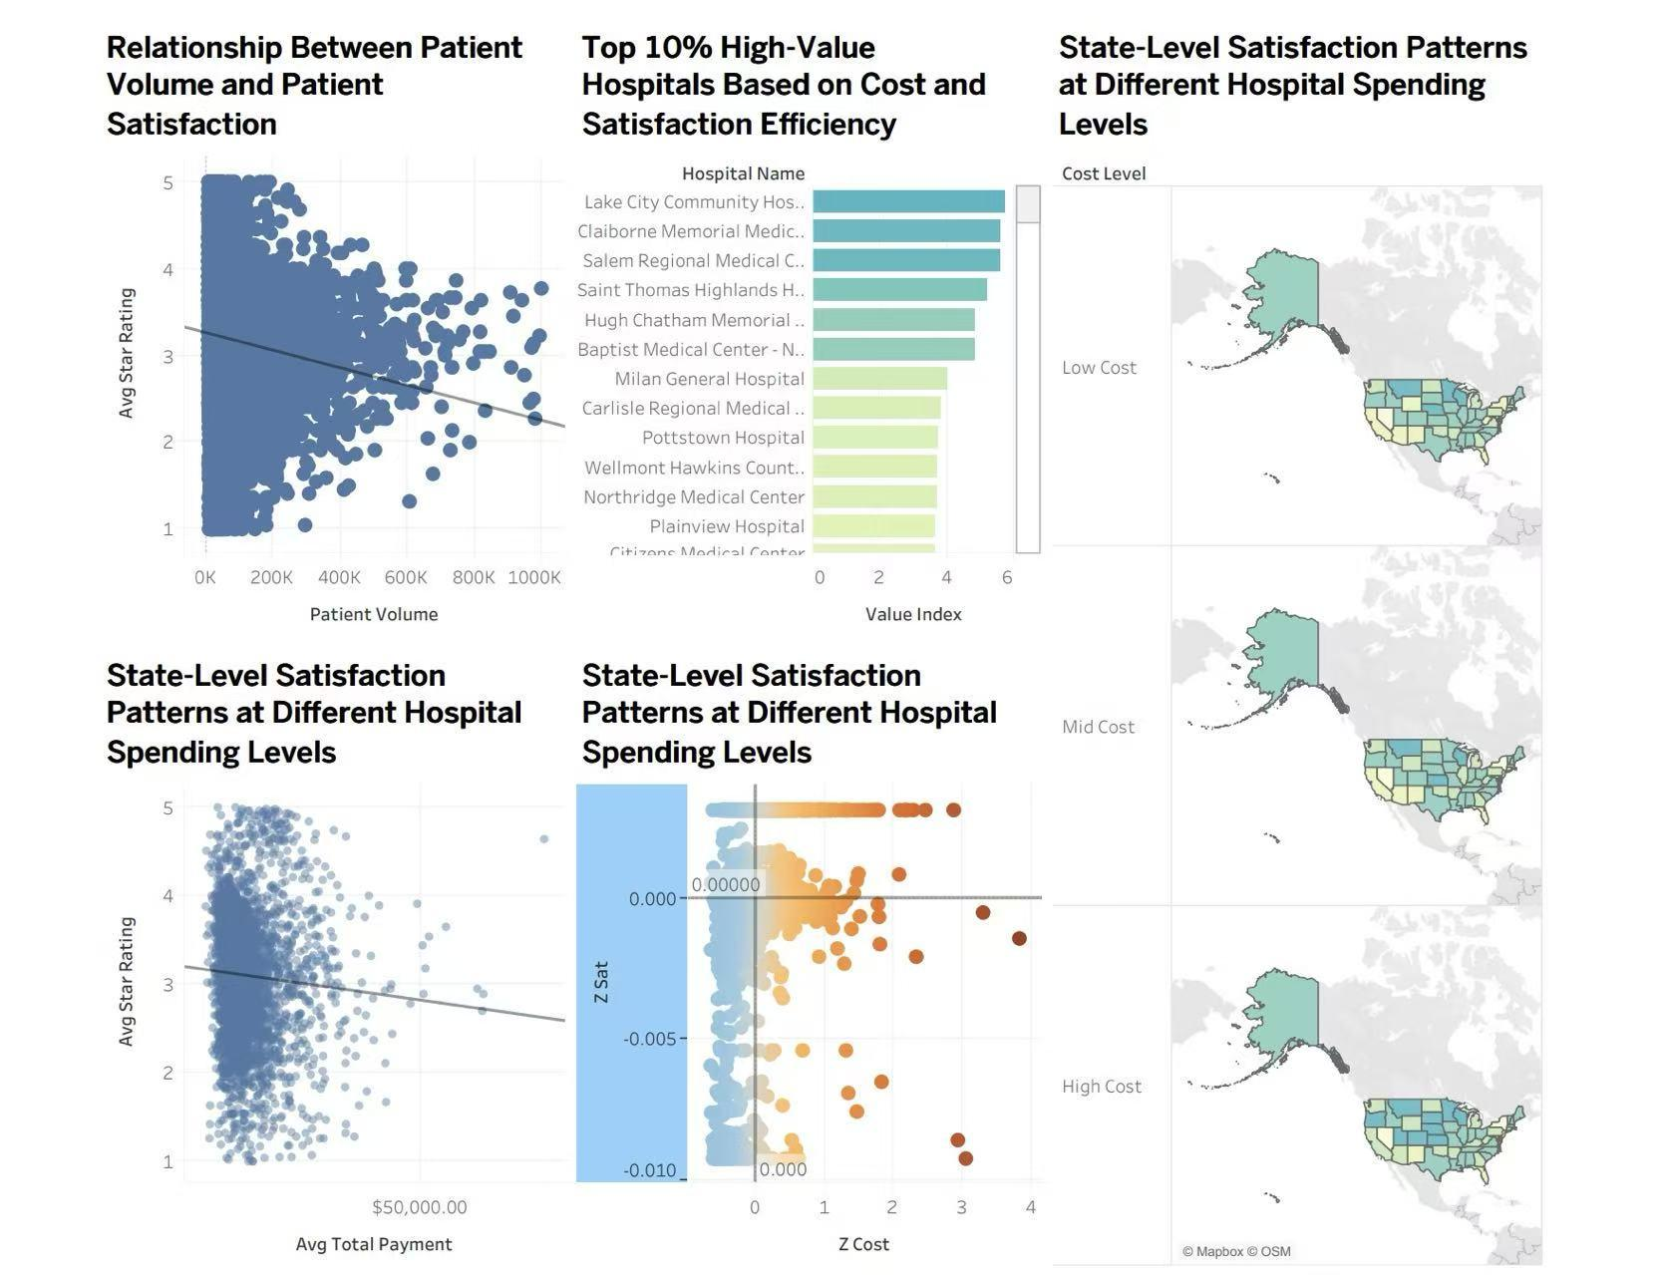
DASHBOARD

Slide 15
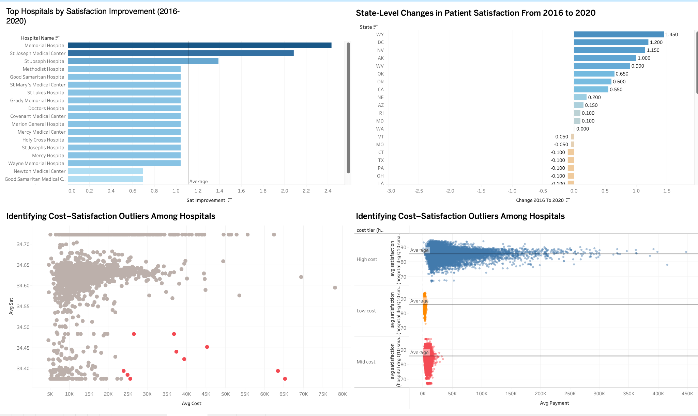
DASHBOARD

Slide 16
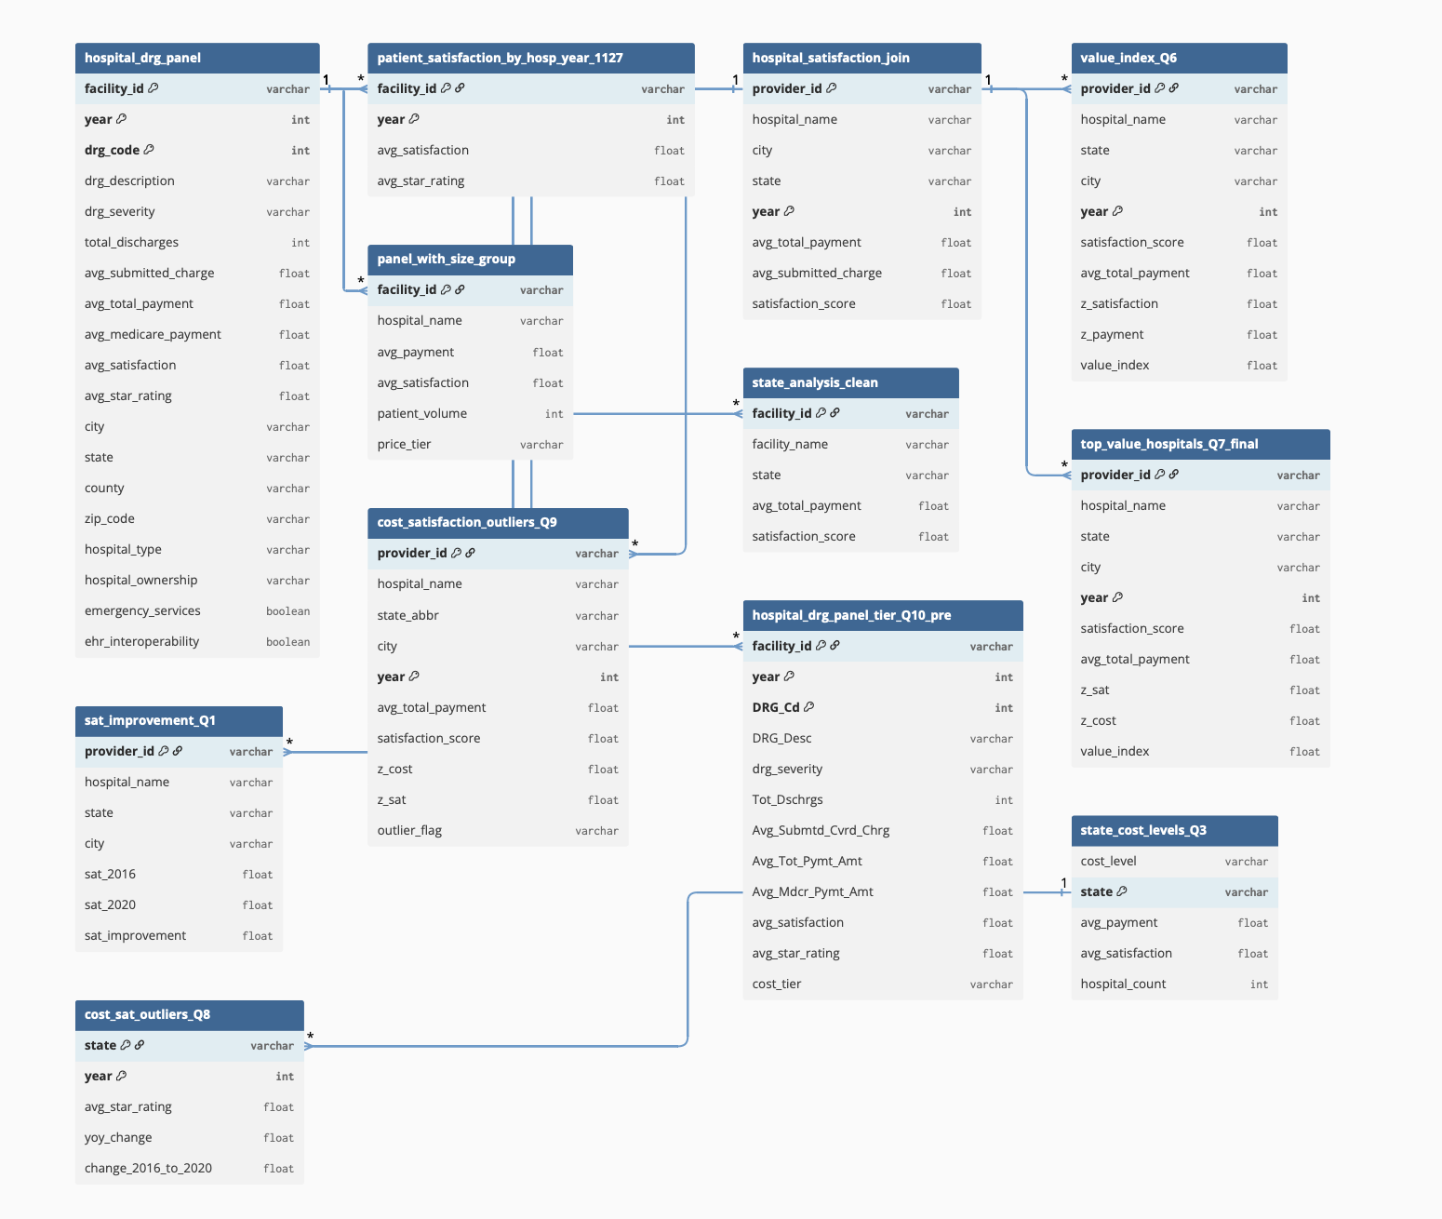
Data Source & Methodology
Entity Relationship Diagram (ERD):
Data Source:
Source: Centers for Medicare & Medicaid Services (CMS).
Volume: 5 years of data (2016-2020), approx. 1.14 GB.
Methodology:
Standardization: Unified Provider IDs (6-digit format) to join Cost and Satisfaction tables.
Metric Creation: Constructed a Value Index using Z-scores to normalize data across different years.

Slide 17

Conclusion & Future Work
06

Slide 18

Conclusion & Recommendations
Summary:
Spending does not meaningfully improve patient satisfaction.
“Value” comes more from operations and patient experience, not from bigger budgets.
Recommendations:
For Stakeholders: Stop assuming budget increases will fix satisfaction issues.
Best Practices: Learn from high-value regional hospitals (e.g., Citizens Medical) to understand what operational practices drive satisfaction.
Metric: Adopt "Linear Mean Value" as a KPI, as it correlates strongly with star ratings.

Slide 19

References & AI Disclosure
References:
CMS Hospital General Information & HCAHPS Survey Data (2016-2020).
BA775 Course Materials.
Generative AI Disclosure:
Tools Used: ChatGPT.
Purpose: Brainstorming outlines, summarizing research, and debugging Python/SQL code.
Statement: All AI-generated content was reviewed, edited, and validated by the team for accuracy and originality.

Slide 20

Thank You！

Slide 21

Question ？

